Slide 1
CUP & STRING COMMUNICATION
Does it really work?
If it does, how does it work?
J Kush 9-2010

Slide 2
DIRECTIONS
Punch a tiny hole in the center of the bottom of each cup with a sewing needle or similar.
Take a piece of 25 feet of non-stretchable thread or kite string and thread each end through each cup hole. The String cannot be tangled!
Tape the string tightly to the bottom inside of the cup.
Two students will work together to spread the cups and the strings apart.

Slide 3
What you need to TRY…
One person will speak while the other person will listen
Try different amounts of tension on the string
Try touching the string when sending a message
Try sending the message around a corner
Try a shorter length of string
Make a chart to record the pros and cons of your communication system if you actually used it every day
Note the results of your trying experiments listed above.
Create a systems model chart for the communication system
You will turn this in for 20 points. Make sure both names are on the paper.
What you need to DO…

Slide 4
SAMPLE PRO & CON CHART
PROS
CONS

Slide 5
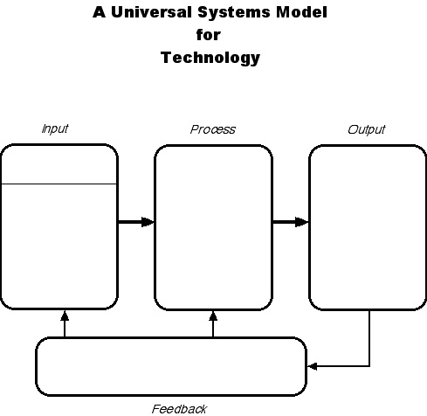
What is the String cup system model?
UNIVERSAL SYSTEMS MODEL

Slide 6
SAMPLE PRO & CON CHART
PROS
CONS
limited by distance
needs straight line without obstruction
(will not work around corners)
not practical for home-to-home use
the line is easily tangled or damaged
will not work in the rain
actual voice heard
two-way
inexpensive
made from basic materials

Slide 7
UNIVERSAL SYSTEMS MODEL
Sound
(the message) comes from the 2nd cup vibrating
Human Voice is put into the 1st cup like a microphone
Vibration transmission down the string line making the other cup vibrate like a speaker
The person listening signals with their hand that they can hear me.

