Slide 1
INVENTION & INNOVATION 7th Grade
Unit 1 Introduction to
Invention & Innovation
J Kush 9-2010

Slide 2
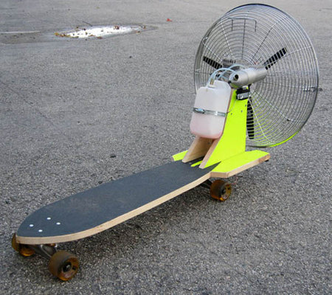
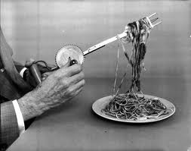
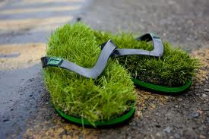
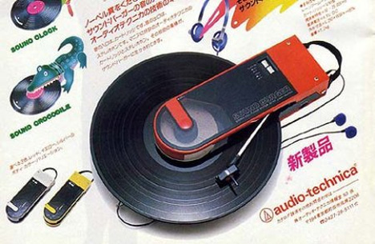
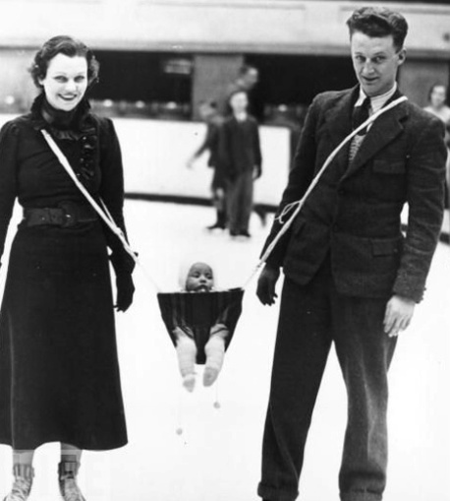
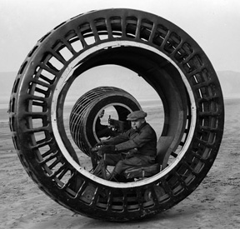
Invention Flops Most inventions are duds-- and even Thomas Edison had plenty of flops. Leonardo da Vinci and Abraham Lincoln both had failed inventions, too, and they've got company: only 3 percent of inventions succeed.

Slide 3
Moon Shot Thinking
Ideas or solutions that address a huge problem, suggesting a radical solution that could work, and use some form of breakthrough technology to make it happen.
Things People Said:
Bad Predictions on Technology

Slide 4
Moon Shot Thinking
There are things more important than money in life when we work hard and keep dreaming. Growing up poor is definitely not a permanent handicap.
What does this mean to you?
“The Boy Who Harness the Wind”

Slide 5
Moon Shot Thinking
Do you have any moon shot ideas?

Slide 6
Activity: Famous Inventors
In groups of 2 identify the three most famous inventors of all time, their inventions, and how the invention may have impacted the way people lived, worked, or produced things.
Next, identify the attributes or personal characteristics of the people cited that made them successful inventors.

Slide 7
The WORST 50 Inventions
On my website, open our class folder and click on the link for Time Magazine’s 50 Worst Inventions.
Quickly browse through the list.
Pick your favorite worst invention and be prepared to share with the class what it does and why it is so terrible!
LET’S INVESTIGATE!!

Slide 8
Invention & Innovation
New products and systems can be developed to solve problems or to help do things that could not be done without the help of technology.

Slide 9
Invention & Innovation
New products and systems can be developed to solve problems or to help do things that could not be done without the help of technology.
Development of technology is a human activity and is the result of individual or collective needs and the ability to be creative.

Slide 10
Invention & Innovation
New products and systems can be developed to solve problems or to help do things that could not be done without the help of technology.
Development of technology is a human activity and is the result of individual or collective needs and the ability to be creative.
Technology is closely linked to creativity, which has resulted in innovation.

Slide 11
Invention & Innovation
INVENTION: the process of designing a new
idea, device, product, or
process that is completely new
using ideas and imagination

Slide 12
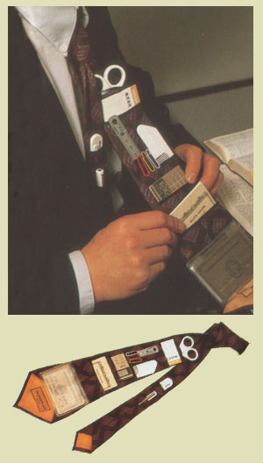
Invention & Innovation
INVENTION: the process of designing a new
idea, device, product, or
process that is completely new
using ideas and imagination
INNOVATION: the process of modifying and
improving an existing idea,
device, product, or process

Slide 13
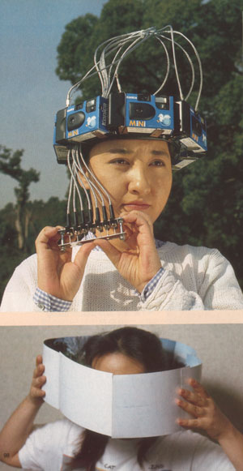
Invention & Innovation
People of all times and all places have increased their capability by innovating and inventing.

Slide 14
Invention & Innovation
People of all times and all places have increased their capability by innovating and inventing.
Invention requires patience, creativity, perseverance, and trouble shooting.

Slide 15
Invention & Innovation
People of all times and all places have increased their capability by innovating and inventing.
Invention requires patience, creativity, perseverance, and trouble shooting.
Technology is closely linked to creativity, which has resulted in innovation.

Slide 16
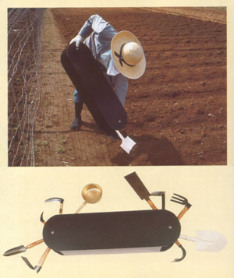
Invention & Innovation
Innovation often involves decreasing the overall capabilities of a product or system in order to increase its ability to perform a more narrow or specific task very efficiently. This process is called specialization of function.

Slide 17
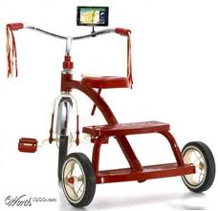
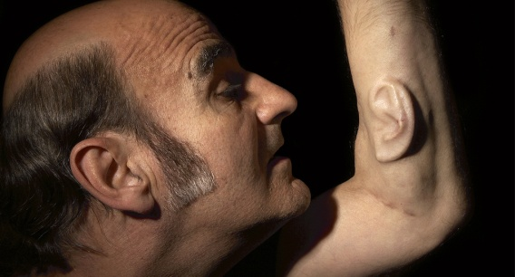
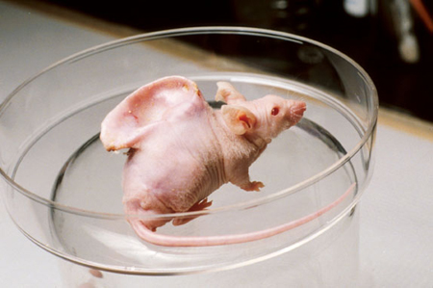
Invention & Innovation
Innovation often involves decreasing the overall capabilities of a product or system in order to increase its ability to perform a more narrow or specific task very efficiently. This process is called specialization of function.
New products and systems
can be developed to
solve problems or to help
do things that could not be
done without the help of
technology.

Slide 18
eLegs Exoskeleton Biotechnology
Can technology help a paraplegic walk again?
What are future possibilities for technology and humans?
VIDEO
VIDEO
VIDEO
VIDEO

Slide 19
Activity: Great Thinkers & Their Inventions
1. As a class we will read the four vignettes.
2. Next, you will pick one of the vignettes to think about.
3. You will identify the needs or desires that were satisfied by the invention.
4. You will identify some of the materials that were needed to make the invention.
5. You will identify some of the tools that were used to make the invention.

Slide 20
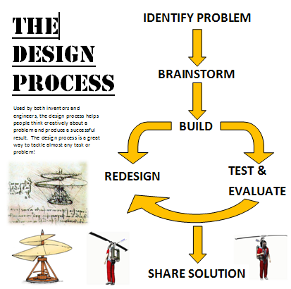
DESIGNING INVENTIONS & INNOVATIONS
Design involves a set of steps that can be performed in different sequences and repeated when needed.

Slide 21
ENGINEERING DESIGN PROCESS
Define the Problem
What is the problem that you are trying to solve?

Slide 22
ENGINEERING DESIGN PROCESS
Brainstorm for Solutions
Write down as many good ideas as possible. Don’t exclude anything!

Slide 23
ENGINEERING DESIGN PROCESS
Generate Ideas
Look at your possible solutions and think of possible ideas.

Slide 24
ENGINEERING DESIGN PROCESS
Identify Criteria
What are the limitations or restrictions for your solution?

Slide 25
ENGINEERING DESIGN PROCESS
Explore Possibilities
Which of your ideas may be possible solutions to the problems?

Slide 26
ENGINEERING DESIGN PROCESS
Select and Approach
Look at all of your ideas and pick the best choice. Usually the simplest solution is the best! K.I.S.S.

Slide 27
ENGINEERING DESIGN PROCESS
Select and Approach
Look at all of your ideas and pick the best choice. Usually the simplest solution is the best! K.I.S.S.
KEEP

Slide 28
ENGINEERING DESIGN PROCESS
Select and Approach
Look at all of your ideas and pick the best choice. Usually the simplest solution is the best! K.I.S.S.
KEEP IT

Slide 29
ENGINEERING DESIGN PROCESS
Select and Approach
Look at all of your ideas and pick the best choice. Usually the simplest solution is the best! K.I.S.S.
KEEP IT SIMPLE

Slide 30
ENGINEERING DESIGN PROCESS
Select and Approach
Look at all of your ideas and pick the best choice. Usually the simplest solution is the best! K.I.S.S.
KEEP IT SIMPLE STUDENT !!

Slide 31
ENGINEERING DESIGN PROCESS
7. Making a Model or Prototype
This is the step where you take your solution and then build it. A model or prototype is a trial or practice version of your solution.

Slide 32
ENGINEERING DESIGN PROCESS
Test and Evaluate the Design
This is when you test your model or prototype to see if it works. Does it meet all of the design criteria?

Slide 33
ENGINEERING DESIGN PROCESS
9. Refine the Design
In this step you make any necessary changes to your design/solution or fix something that does not work!

Slide 34
ENGINEERING DESIGN PROCESS
Define the Problem
Brainstorm for Solutions
Generate Ideas
Identify Criteria
Explore Possibilities
Select and Approach
Making a Model or Prototype
Test and Evaluate the Design
Refine the Design

Slide 35
ENGINEERING DESIGN PROCESS
Define the Problem
Brainstorm for Solutions
Generate Ideas
Identify Criteria
Explore Possibilities
Select and Approach
Making a Model or Prototype
Test and Evaluate the Design
Refine the Design
You can always go back and rework any step as necessary.

Slide 36
Basic Laboratory Safety Rules
Do you know the safety rules for our hands-on activities in the laboratory and classroom?
1. Take a brief tour of the laboratory
2. Review the safety rules on the
“Basic Safety Rules” handout
3. Take the basic safety rules quiz
34 points

Slide 37
Design Brief: Jelly Bean Dispenser

Slide 38
REVIEW for the TEST!

Slide 39
What you NEED to KNOW!!!
new products and systems can be developed to solve problems or to help do things that could not be done without the help of technology
the development of technology is a human activity and is the result of individual or collective needs and the ability to be creative
technology is closely linked to creativity, which has resulted in innovation

Slide 40
What you NEED to KNOW!!!
Define the terms invention and innovation.
Design and make a simple invention.
Design involves a set of steps that can be performed in different sequences and repeated when needed.

