Slide 1
Keystone Ecology

Slide 2
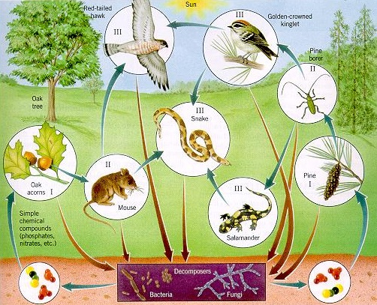
1) What is Ecology?
Ecology → The study of relationships and interactions of living things with one another and their environment
A food web like this one gives us a good look at some of the different ways organisms interact within their habitat.

Slide 3
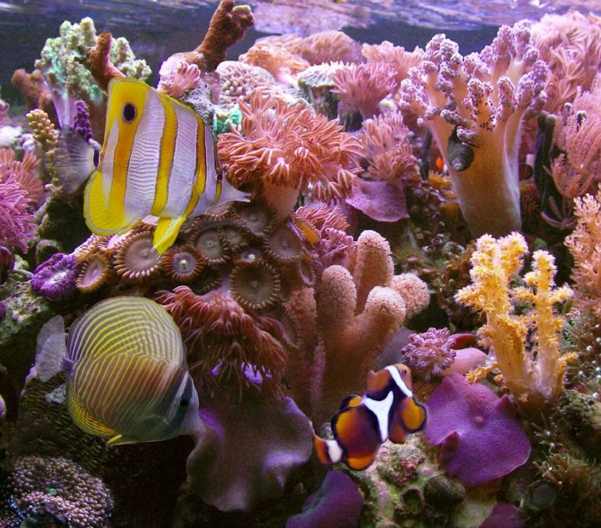
Living vs. Non-Living
All the living things in a particular environment are called…
Biotic factors
All the non-living things are called…
Abiotic factors
HINT → As you probably know, the root word bio means “life”, so abiotic simply means “not living”.

Slide 4
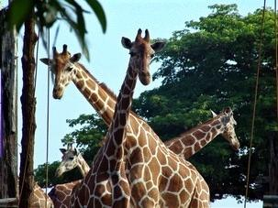
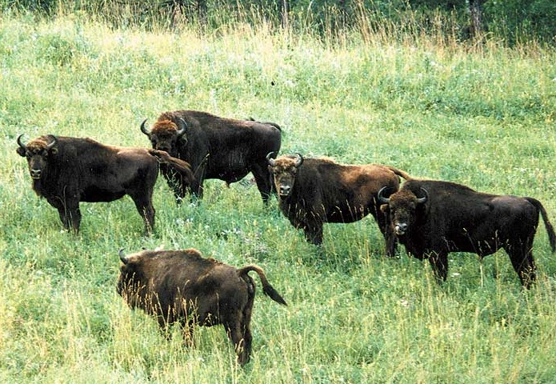
Population
A population refers to all organisms of a single species that live within a certain area.
Look at these examples. What distinct populations are visible?
Giraffes, buffalos, grass, trees

Slide 5
Community
In ecological terms, a community refers to all of the different organisms that live within a certain area.
Remember, this includes not just animals, but plants and all other living things as well.
A community consists of many different populations interacting and coexisting alongside one another.

Slide 6
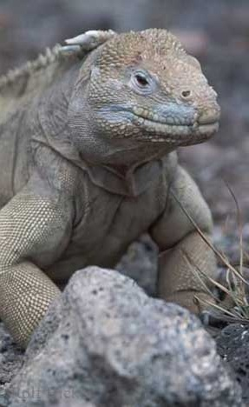
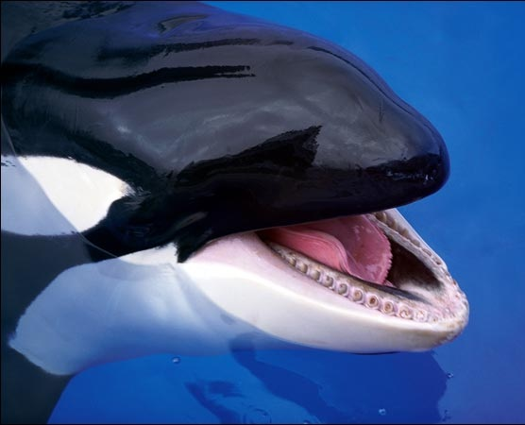
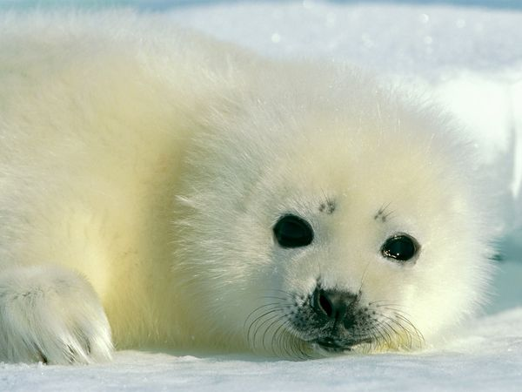
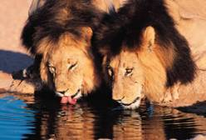
Habitat
An organism’s habitat refers to the physical environment where it lives.
This includes mainly the abiotic factors
What are these animals’ habitats?
Picture the type of environment where you’d expect to find each one.

Slide 7
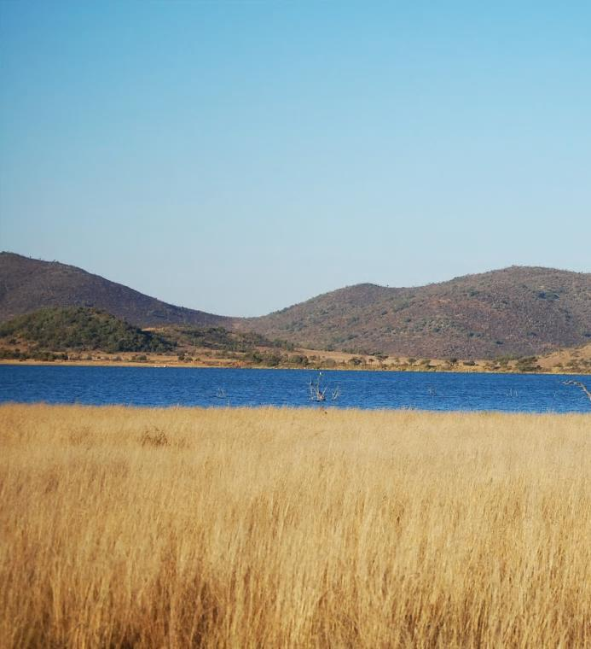
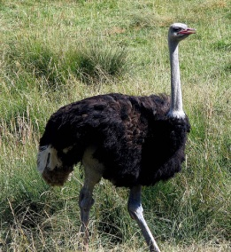
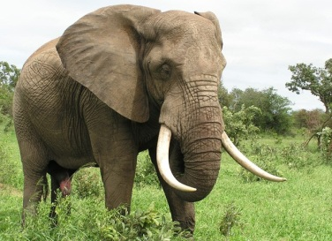
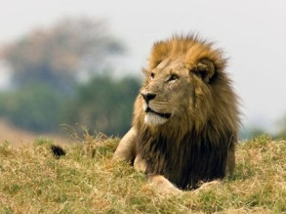
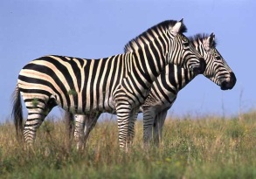
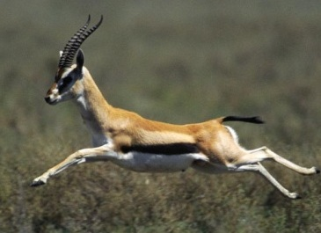
Putting Them All Together
When you include all the entire community of different species (multiple populations) AND the habitat they live in, you’re now talking about a whole…
Community
+
Habitat
= Ecosystem

Slide 8
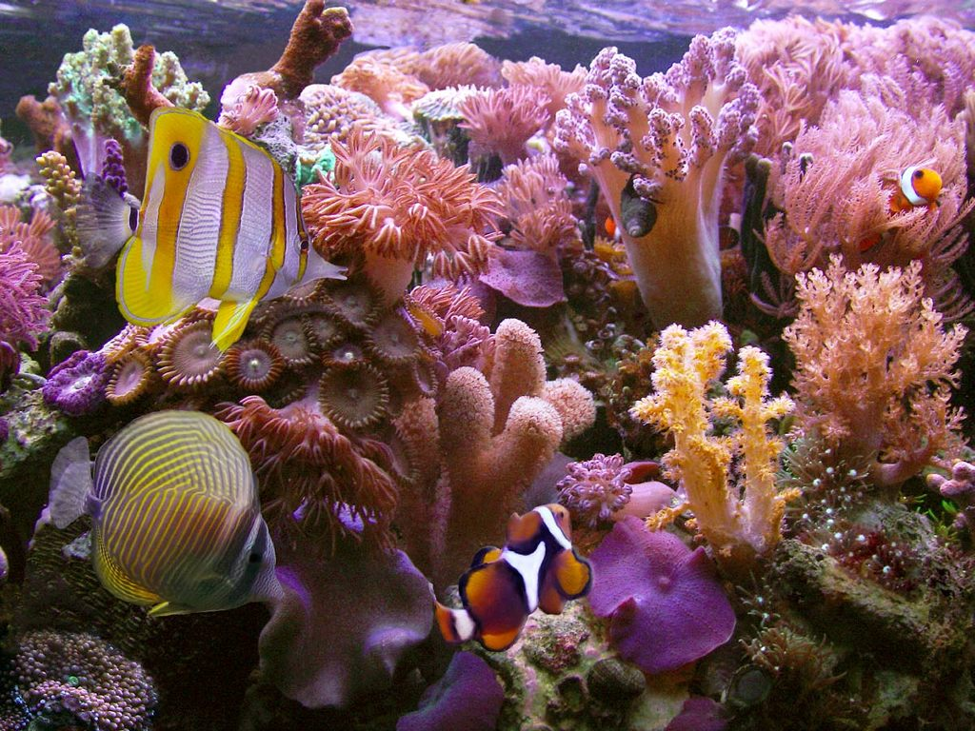
Ecosystem
An ecosystem is…
Any ecosystem consists of very finely balanced factors including organisms which have “coevolved” (evolved together) over millions of years.
All the organisms AND their physical environment
Made up of the community AND habitat
An interaction of biotic AND abiotic factors

Slide 9
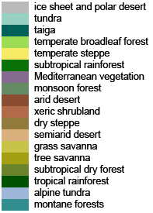
Biomes
A biome is a large region characterized by a specific type of climate and certain types of plants and animals.
What different biomes can you name?

Slide 10
Biosphere
All of the different environments on our planet make up what we call the biosphere, literally the “sphere of life”.
This term refers to all the places on Earth where life exists.
Life on Earth is only found a few miles above or below sea level (near the surface).
This can be broken up into subcategories:
Atmosphere
Hydrosphere
Lithosphere
ALL LIFE
AIR
WATER
LAND
(Litho means “rock”.)

Slide 11
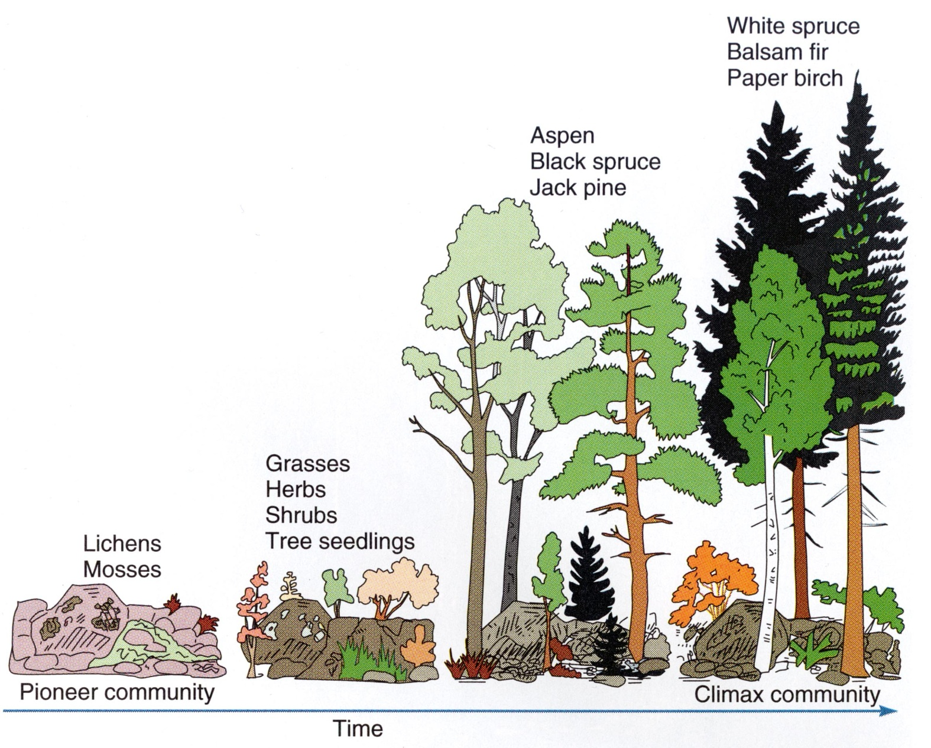
Ecological Succession
Strong ecosystems take a very long time to be colonized and have all its potential niches “filled in”, which we call a climax community.
This process of organisms essentially building a new ecosystem from the ground up is called ecological succession.
Starting from scratch, this can take thousands or even millions of years!

Slide 12
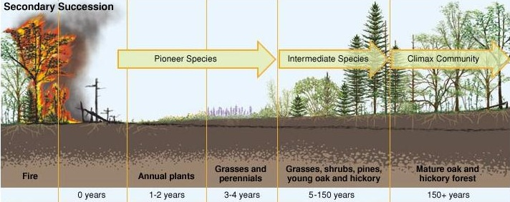
Secondary Succession
When an earlier ecosystem is wiped out, a new one will gradually form in its place, and this process happens much quicker because soil and some tiny organisms are already present.
This is called secondary succession.

Slide 13
Maintaining Healthy Ecosystems
Because of these “coevolved” relationships, completely different species rely heavily on each other for their mutual survival.
The more complex interactions there are, the greater the biodiversity, and the healthier the ecosystem.
Changes that directly affect or harm one factor of an ecosystem almost always have unforeseen consequences for many species.
If changes occur too quickly for species to adapt, the result is often…
Extinction

Slide 14
1) What is Ecology?
2) Ecological Interactions
3) Nutrient Cycles
Section 2 of 4:
Ecological Interactions

Slide 15
Simple Food Chain
Top predator
If one of these species were to be driven out by human interference or were to go extinct entirely, what do you think would happen?
Would the food chain break down?
Carnivorous predator
Insectivore
If there is enough biodiversity in the ecosystem, then probably another species would step in and fill that niche.
For example, if all the mice were wiped out, there are probably other insectivores in the area that could “play the same part”.
Herbivore
Producer

Slide 16
Simple Food Chain
Notice that the arrows in this food chain all point upward. This is because they do NOT indicate what the food source is. Rather, they show the flow of energy through the ecosystem.
In this example, the flower starts out with the energy, which it “produced” through photosynthesis. (In reality, we of course know that the flower is not “making” this energy from scratch but obtaining it in the form of light radiation from the Sun.)

Slide 17
Trophic Levels
The organisms on a food chain can also be described in terms of their trophic level (trophic means “food” or “feeding”).
This describes the organism’s level from the bottom of the food chain, meaning how many different organisms the energy has passed through to get to it.
The snake in this chain is a “tertiary” (third) consumer because it’s three levels up from the producer.

Slide 18
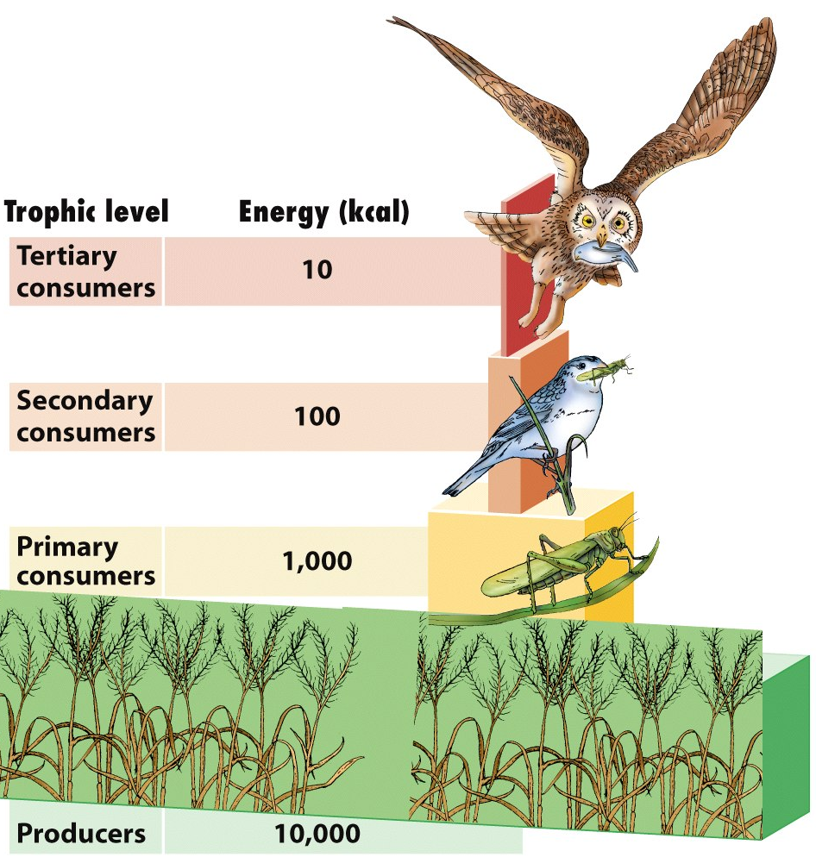
Energy Pyramids
Since energy is always lost as it is transferred, the amount of total energy (or biomass) decreases as we move up the pyramid.
There will always be a much greater overall number of producers than there will be of the organisms that consume the plants.
Top predators have a much lower population than animals below them on the chain.
As you can see, the amount of energy decreases by a factor of TEN for each level you move up the energy pyramid.
In other words, when one organism eats another, 90% of the energy is lost or used up and only 10% passes into the consumer.

Slide 19
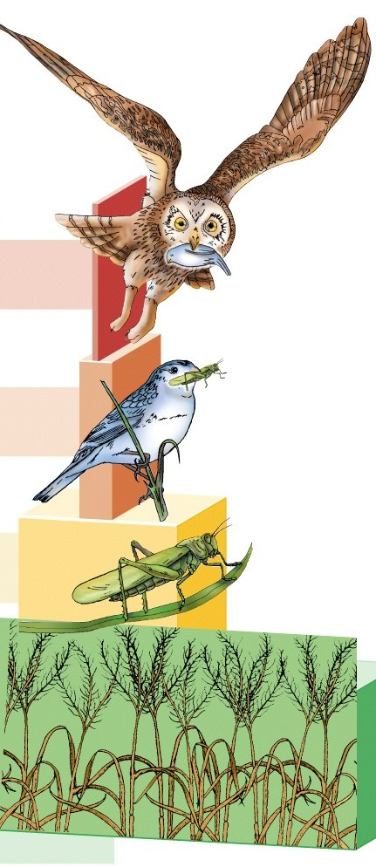
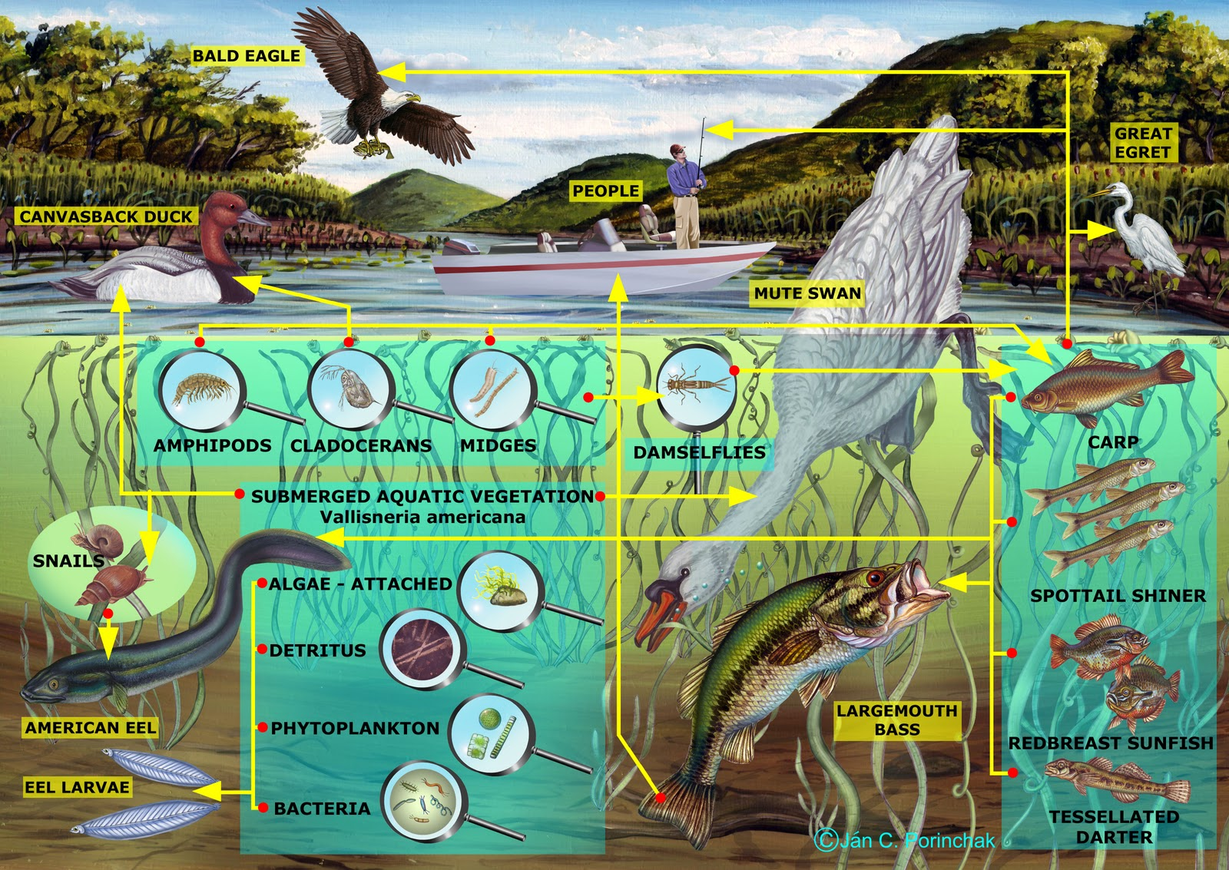
Food Webs
In reality, ecosystems are much more complex than a single food chain.
That’s why a food web can be handy to give us a much better picture of all of the different connections in an ecosystem.

Slide 20
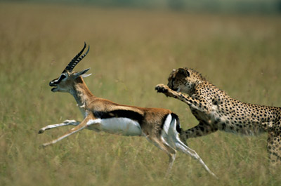
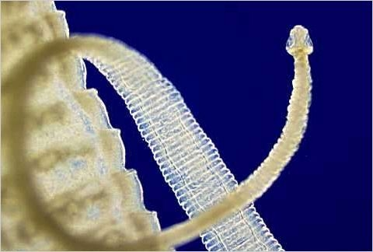
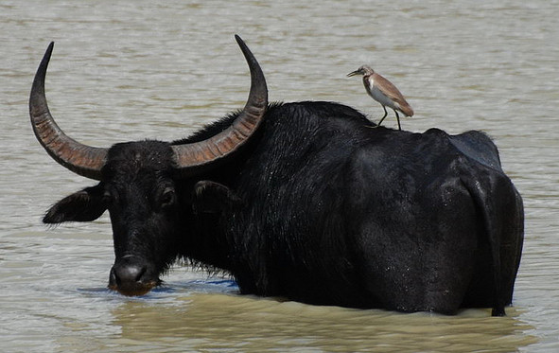
Ecological Relationships
Click the images below to see a few types of interspecies relationships that are common in most ecosystems.
Predator-Prey
Parasitism
Symbiosis

Slide 21
Predator-Prey
Predation → When one animal actively hunts and feeds on another live animal (its prey)
A cheetah and gazelle are an obvious example of a classic predator-prey relationship.
You can probably figure out which is which.
In nature, of course, there are thousands of different predator-prey relationships.
Many are much more subtle than this example.
Back to
Ecological Relationships
Slide

Slide 22
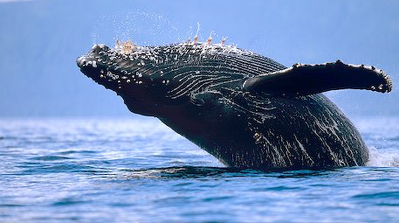
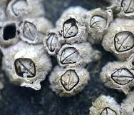
Symbiosis
There are a two main types of symbiotic relationships:
Mutualism:
Two species who each benefit from the other
Commensalism:
Only one species benefits while the other is unharmed
This water buffalo gets the bugs picked off while the oxpecker bird gets a free meal.
Barnacles are tiny shelled crustaceans which often hitch a ride on an unsuspecting whale.
You can probably think of many other examples of symbiotic relationships.
Back to
Ecological Relationships
Slide

Slide 23
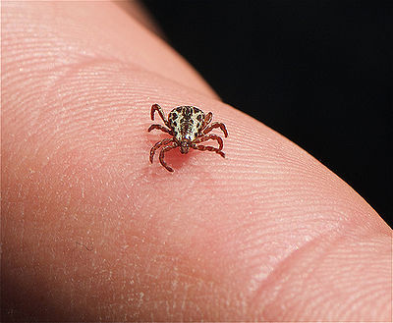
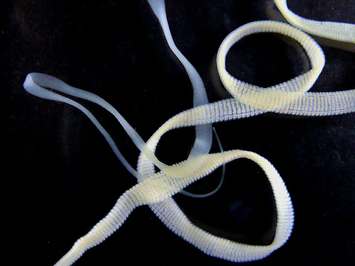
Parasitism
Parasites are organisms which live in or on another species called a host.
The host’s body becomes the temporary habitat for the parasite.
Dog tick
Tape worm
Parasites generally don’t kill their hosts because that would leave them without a home.
Back to
Ecological Relationships
Slide

Slide 24
Coevolution
Predator-Prey
Remember:
All of these types of ecological interactions are a result of different species evolving together over millions of years.
This is called “coevolution”
This long-term coevolution is what gives ecosystems stability and resiliency.
Symbiosis
Parasitism
It also explains why it is so easy for humans to disrupt ecosystems.
Back to
Ecological Relationships
Slide

Slide 25
1) What is Ecology?
2) Ecological Interactions
3) Nutrient Cycles
Section 3 of 4:
Nutrient Cycles

Slide 26
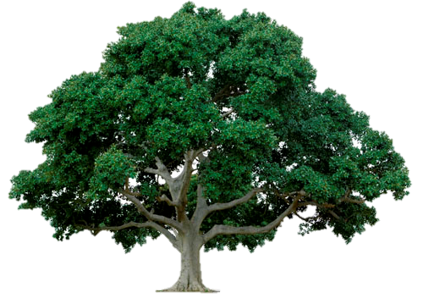
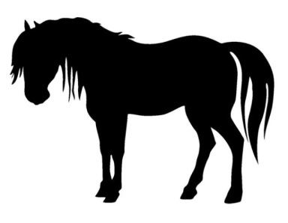
The Carbon Cycle
This is one of the fundamental biological interactions that make up the carbon cycle.
CO₂
By doing photosynthesis, plants are essentially building themselves out of the carbon they take in from the air (with some help from the Sun!)
O₂
This part of the carbon cycle doesn’t add any new carbon dioxide to the atmosphere because it’s just recycling the same carbon over an over again into different living things.
NOTICE:

Slide 27
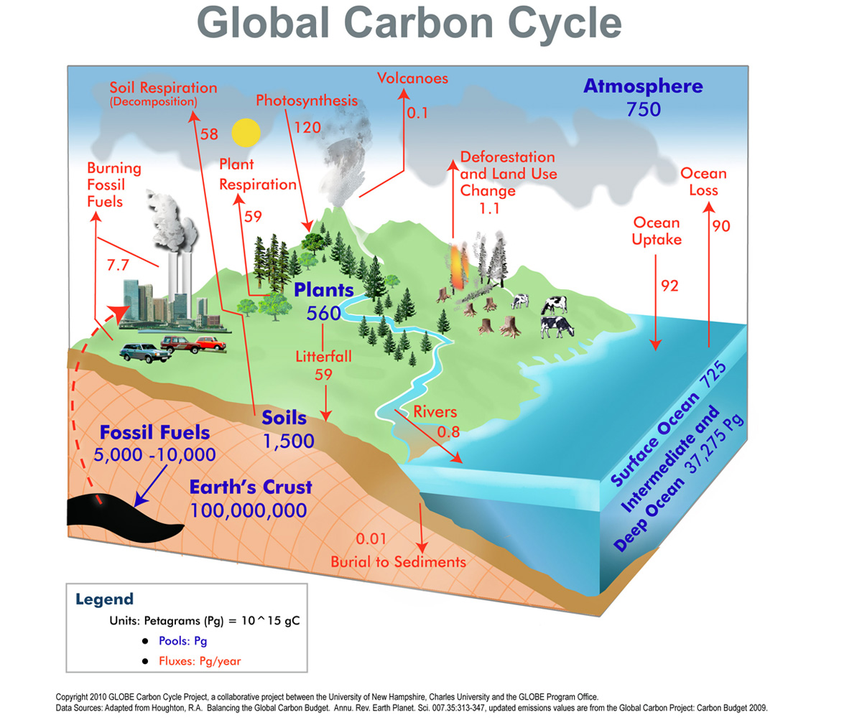
The Carbon Cycle
This diagram shows the main places carbon is stored on our planet.
It also shows the processes that either absorb carbon from the air OR release carbon back into the atmosphere as CO₂.

Slide 28
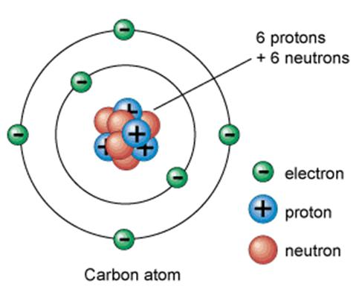
Other Nutrient Cycles
CO₂
O₂
The balance of the carbon cycle is critical for the survival of all life on Earth, but there are other important substances that cycle their way around our planet in similar ways.

Slide 29
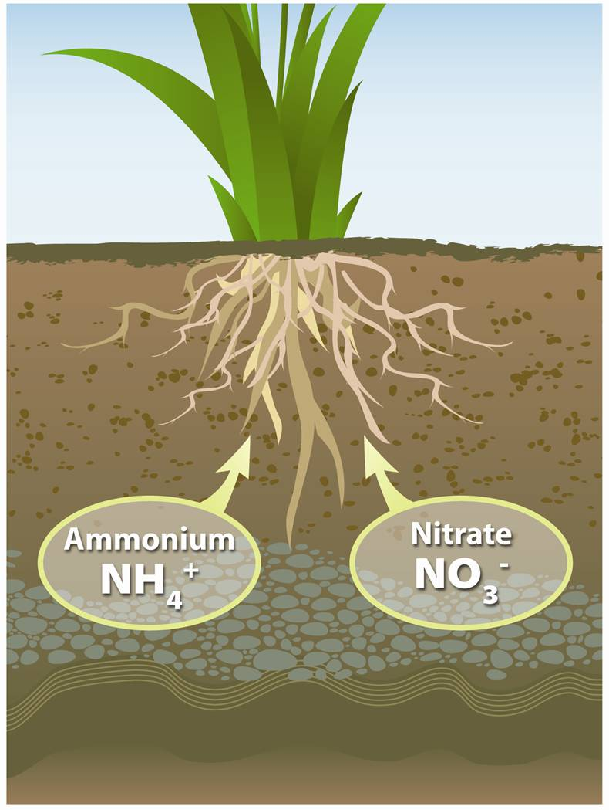
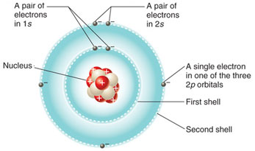
The Nitrogen Cycle
In addition to taking in carbon through their leaves (in the form of CO₂), plants also take in nitrogen through their roots.
This nitrogen is found in nitrates and other nutrients. This is why farmers add fertilizer to the soil.
Nitrogen atom

Slide 30
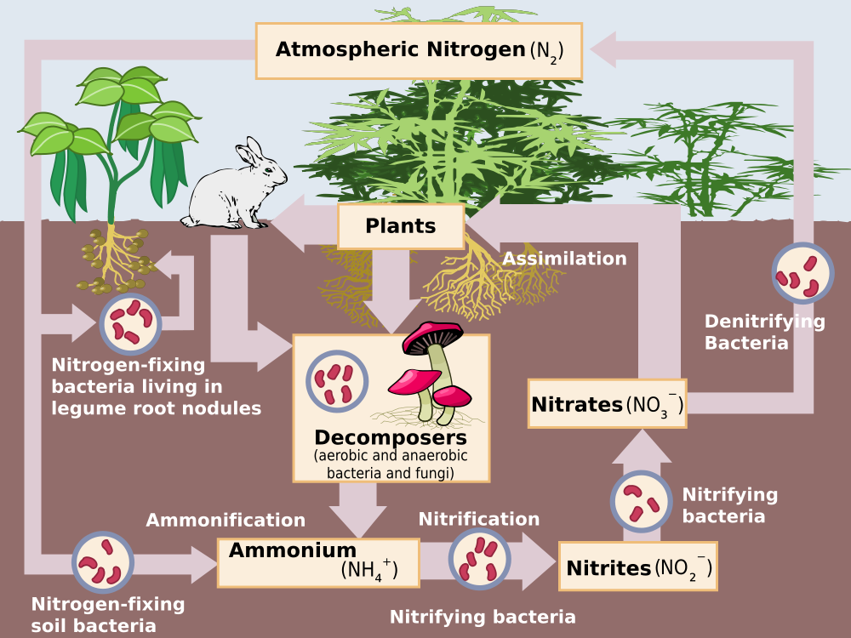
The Nitrogen Cycle
The nitrogen cycle involves lots of different organisms that live on and in the ground. Among the most important of these are:
Nitrogen-fixing bacteria, found in plants’ roots, which convert N₂ gas into nitrate nutrients for the plant.
Soil bacteria which convert the nitrates back into atmospheric nitrogen.

Slide 31
The Water Cycle
And, of course, water circulates around the planet in its various forms: as a solid, liquid, and a vapor.
Water molecule
Some processes of the water cycle:
evaporation
condensation
precipitation
transpiration
runoff

