Slide 1
2024-2025 New Student Orientation
August 21st, 2024

Slide 2
Welcome and Introduction
Mr. Hale – Elementary Principal
21 Years in the Rockwood Area School District
16th year as Principal of the Rockwood Elementary School.
Previously a Special Education Instructor within the Jr./Sr. High School.
Masters in Education from California University of Pennsylvania
Bachelors in Education from Saint Francis University

Slide 3
Rockwood Elementary
Home of the Lil Rockets!
District Mission Statement:
"The mission of the Rockwood Area School District is to empower students to reach their full potential as well-rounded, lifelong learners and responsible members of society.“
Academics: Our goal is to challenge each student at their ability level and to support their academic growth within all subjects.

Slide 4
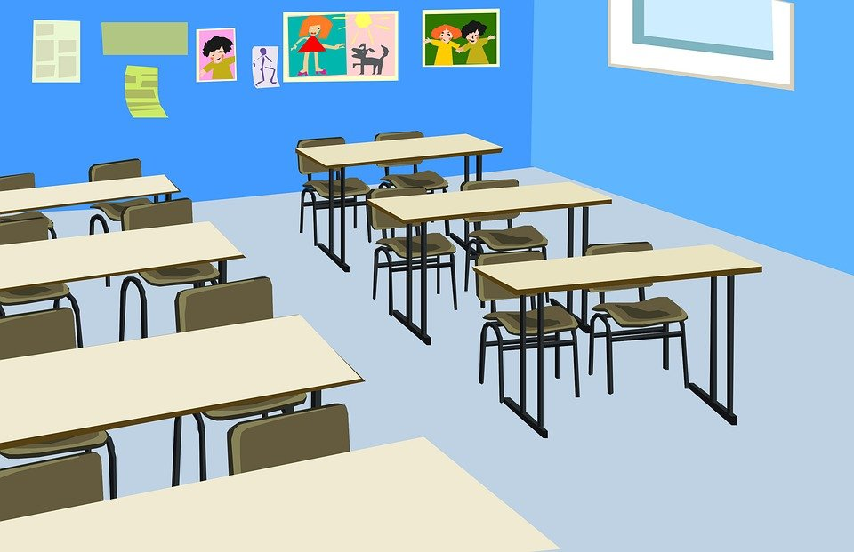
Classroom Structure:
Kindergarten - 3 (15)
1st Grade - 2 (19)
2nd Grade - 2 (23)
3rd Grade 2 (17)
4th Grade - 2 (20)
5th Grade - 3 (20)
6th Grade 2 (19)
3rd, 4th, and 5th grade will move to classes in a departmentalized fashion.
Elementary Classrooms - Collaborative and focused on small group instruction.

Slide 5
Rockwood Elementary School
The Rockwood Elementary services students in Kindergarten through 6th grade.
Currently awaiting Pre-K Counts Grants for Pre-K program establishment.
Students receive instruction from teachers that are highly qualified as required by the ESSA/Every Student Succeeds Act.
Academic subjects taught: Reading, Mathematics, Science, Social Studies, Writing, Technology/Computers, Music, Art, Library Science, Physical Education, and Guidance.

Slide 6
School Day and Start Date:
First day of school is August 27th, 2025
Student report to homeroom at 7:45am
Dismissal is 2:51pm
Parent Pick-up 2:51pm

Slide 7
Daily Academic Schedule
6 Day Academic Rotation
Children will receive academic instruction in the areas of Reading/Language Arts, Mathematics, Science, Social Studies, Art, Library, Music, Guidance Lessons, and Physical Education.
Kindergarten – 2nd Grade
Guided Reading: 1 X per day for 30 minutes.
Kindergarten – 3rd Grade will participate in DIBELS 8th Ed. assessments.
Children that demonstrate academic difficulties in the area of Reading will be referred to the Title I Reading Program. Title I is a Federal Program that supports struggling learners. Our program offers 30 minutes of supplemental instruction each day. Reading specialists provide this instruction.
Multi-Tiers of Support System procedures will conducted in Kindergarten through 3rd grade during the school year. WINNERS Program - What I Need Now Enrichment and Review Supports. K - 3rd grade. 60 minute program.

Slide 8
Daily Academic Schedule
4th, 5th and 6th grade will participate in STEM education in the afternoons dependent upon grades.
Acceleration period is 30 to 40 minutes every day to support tutoring and enrichment in 4th, 5th, and 6th grade.
Core subjects have extended time frames for instruction
Career education has also been placed in the schedule.
Google apps and classroom will be used and taught.

Slide 9
Title I
Title I is a Federal Program that focuses on closing the achievement gap between students of varying family incomes.
Our school program is school wide and students in Kindergarten through 3rd grade can receive services in reading.
This program provides funding to support our Reading Specialist positions.
Reading Specialists also support the MTSS efforts to provide intense interventions to struggling students.

Slide 10
Multiple Tiers of Support System
The Multi-Tiered Support System practice and procedures will be implemented during the school year in Kindergarten through 3rd grade. Students demonstrating difficulties in reading will receive tiered supports. Interventions are provided in regards to time length of instruction and student need.
Tier I students will receive core instruction within the classroom. (90 minutes)
Tier II students will receive an additional 30 minutes of instruction in a small group setting.
Tier III students will receive an additional 60 minutes of instruction in a small group/one on one setting.

Slide 11
Parent Information
Student Drop-off: (7:45 to 8:05 am)
Student Pick-Up: (2:50 to 3:00pm) please arrive prior to 2:50pm.
Please stay in the line of vehicles.
Do not park in the line or in the parking spaces.
If possible, pull all the way up to the cone on the sidewalk
Please stay in your vehicle.
All children should enter and exit the vehicle on the passenger side of the vehicle. Please have your child ready to exit when you near the cone or sidewalk.
Please have your child enter and exit the vehicle when they are on sidewalk.
Please exit on the passenger side of the vehicle.
After dropping or picking up your child, please check your surroundings and move forward with traffic.
Please be patient with staff and other parents in this process.
Elementary Parking Lot: Closed to Parent Vehicles
The safety of our students is of great concern to us. Restricted access to the elementary school is done with safety in mind. School buses will be unloading students from 7:30am until 8:15am and in the afternoon they will be loading students from 2:45pm until 3:40pm.

Slide 12
Parent Involvement
The RAES administration, faculty, and staff invites parents to visit the school, your child’s classroom, and to participate in a number of school/classroom events that will be held throughout the school year.
Parents are a child’s first teacher and a parent’s attitude, outlook toward, and support related to education has a direct correlation to a child’s academic success.
Please review school materials sent home as important information from teachers and the school comes home almost daily.
Parent involvement sessions and other fun school activities take place throughout the year. Please plan to attend as many events as possible. Examples: PTO Family Reading and Fun Nights, Trunk or Treat, and Parent Educational Sessions.

Slide 13
Procedures/Student Handbook
Bus Notes/Changes
For Safety purposes:
1. Requests for bus changes made by telephone WILL NOT be permitted. Our goal is not to inconvenience you, but to ensure safe and proper transportation for your child. Students will only be dropped off at their listed Primary, Secondary, and emergency stops.
2. A separate note is required for each student. ( Notes for multiple children, even from same family, will not be accepted.)
3. Please limit bus changes. It is our priority to provide a safe experience at Rockwood Area School. Last minute bus changes makes it very difficult to properly account for each student. When writing a bus change note, please include the following information:
1. FIRST and LAST NAME of student.
2. NAME of Homeroom Teacher.
3. GRADE of Student.
4. DATE that bus change will occur.
5. DESTINATION that the excuse child will be going to.
6. BUS # student will be changing to.
7. SIGNATURE of parent.

Slide 14
Procedures/Student Handbook
Attendance
Students should be present before 8:05am. If a student arrives after 8:10 they will be considered tardy. Parents must sign their child in if they arrive later than 8:05am.
Students are required to turn in an excuse within three days of the absence.
Parent Notification Letters are sent for the following;
10 Days Absent
15 Days Absent
3 Illegal Absences – 4th illegal day referral to office to develop truancy elimination plan.
Blue “Educational Trip” Forms - If a student is going to miss school for an educational absence, a Parent Request for Student Absence form must be completed and returned to the Elementary School Office prior to the date(s) of absence. The Principal can approve up to 10 days of educational absences. However, it should be noted that these absences count in the students overall attendance records. Please refer to the Attendance Policy in the Student Handbook.

Slide 15
Parent Resources:
Rockwood School District Website:
www.rockwoodschools.org
Rockwood Elementary School Website:
http://www.rockwoodschools.org/pages/RASD/Elementary/Elementary
Pa State Parent Advisory Council:
http://www.miu4.org/spac
Pa Core Standards:
http://www.pdesas.org/Standard/PACore
Rockwood Elementary Student Handbook
Distributed on the first day of school and posted on the RASD website

