Slide 1
Scale of Reference
Look at the next slide.
What structures are being compared?
What is the current tallest structure in the world?
On the third and fourth slide, watch the YouTube videos. The videos will show the size of other celestial bodies in comparison to the Earth. It’s AMAZING!
Write a definition for the term “Scale of Reference” on your handout.

Slide 2
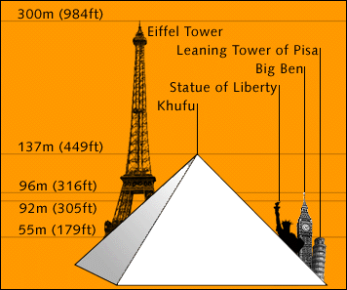
Scale of Reference

Slide 3
SCALE OF REFERENCE: Celestial Bodies

Slide 4
SCALE OF REFERENCE: Celestial Bodies

